Slide 1

jQuery

Slide 2
Content
jQuery Effects
Fade
Slide
Callback
Animate
stop()
Chaining
Final Project Proposal

Slide 3
Fade
fadeIn()
fadeOut()
fadeToggle()
fadeTo()-allows fading to a given opacity (value between 0 and 1)
$(selector).fadeIn(speed,callback);
The optional callback parameter is a function to be executed after the fading completes.
https://www.w3schools.com/jquery/tryit.asp?filename=tryjquery_fadein
https://www.w3schools.com/jquery/tryit.asp?filename=tryjquery_fadeto
Notes:
How to make the last div fade out after fade in?
$("#div3").fadeIn(5000, function(){
$("#div3").fadeOut(1000);
$("#div3").fadeIn(3000).fadeOut(2000);
$("#div3").fadeIn(3000).fadeTo(2000, 0.2);

Slide 4
Sliding
slideDown()
slideUp()
slideToggle()
Syntax:
$(selector).slideDown(speed,callback);
https://www.w3schools.com/jquery/tryit.asp?filename=tryjquery_slide_toggle
Notes:
$("#panel").slideToggle(1000);

Slide 5
jQuery Callback Functions
A callback function is executed after the current effect is finished.
Typical syntax: $(selector).hide(speed,callback);
$("button").click(function(){ $("p").hide("slow", function(){ alert("The paragraph is now hidden"); }); });
https://www.w3schools.com/jquery/tryit.asp?filename=tryjquery_hide_callback
Notes:
Is the same as?
<script>
$(document).ready(function(){
$("button").click(function(){
$("p").hide("slow");
alert("The paragraph is now hidden");
});
});
</script>
Does it work
function myfunction () {
alert('The paragraph is now hidden');
}
$("button").click(function(){
$("p").hide("1000", myfunction());

Slide 6
Try them to see the difference
var fun1= function myfunction () {
alert('The paragraph is now hidden');
}
$("button").click(function(){
$("p").hide("1000", fun1);
});
function myfunction () {
alert('The paragraph is now hidden');
}
$("button").click(function(){
$("p").hide("1000", myfunction());
});
function myfunction () {
alert('The paragraph is now hidden');
}
$("button").click(function(){
$("p").hide("1000", myfunction);
});
Notes:
Without it you are just referring to the function not what it returns.

Slide 7
Try them to see the difference
function myfunction () {
return 0.2;
}
$("button").click(function(){
$("p").fadeTo("1000", myfunction());
});
function myfunction () {
return 0.2;
}
$("button").click(function(){
$("p").fadeTo("1000", myfunction);
});

Slide 8
Animate
Syntax:
$(selector).animate({params},speed,callback);
https://www.w3schools.com/jquery/tryit.asp?filename=tryjquery_animation1

Slide 9
How to use jQuery to make the zombie walk across the screen?
$("#wrapper").animate({left: '+=10px' });
Notes:
setInterval(function(){
$("#wrapper").animate({left: '+=10px' });
},500);

Slide 10
How to stop the zombie?
The jQuery stop() method is used to stop an animation or effect before it is finished.
https://www.w3schools.com/jquery/tryit.asp?filename=tryjquery_stop_slide
Notes:
Does stop() work to stope the zombie? Why?
$("#wrapper").click(function(){
clearInterval(intv);
});

Slide 11
Method Chaining
allows us to run multiple jQuery commands, one after the other, on the same element(s).
https://www.w3schools.com/jquery/jquery_chaining.asp
Notes:
Try
$("div").animate({left: '250px'}, 1000).hide(1000);
Try remove 1000 to see the difference

Slide 12
In-class exercise 3 is due tonight
Only need to make the sliders work

Slide 13
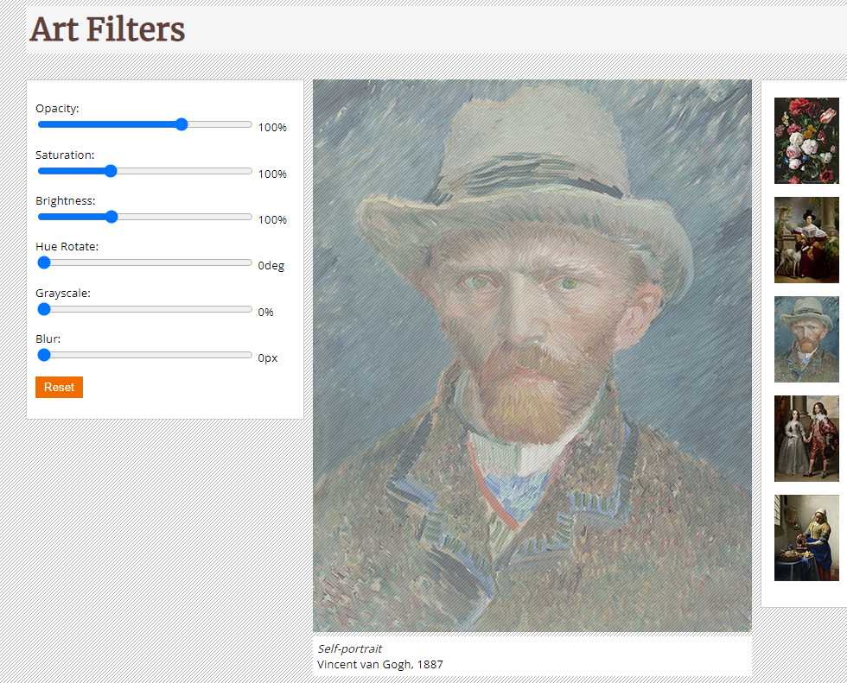
Extra question for you to think: How to enable the reset button?
Click reset to remove filters
Notes:
$("#resetFilters").on("click", function() {
var bigImage = $('#imgManipulated img’);
bigImage.css('filter', 'none');
});
When you click the button, if it refresh the page, try to add type="button“ to the button in html

Slide 14
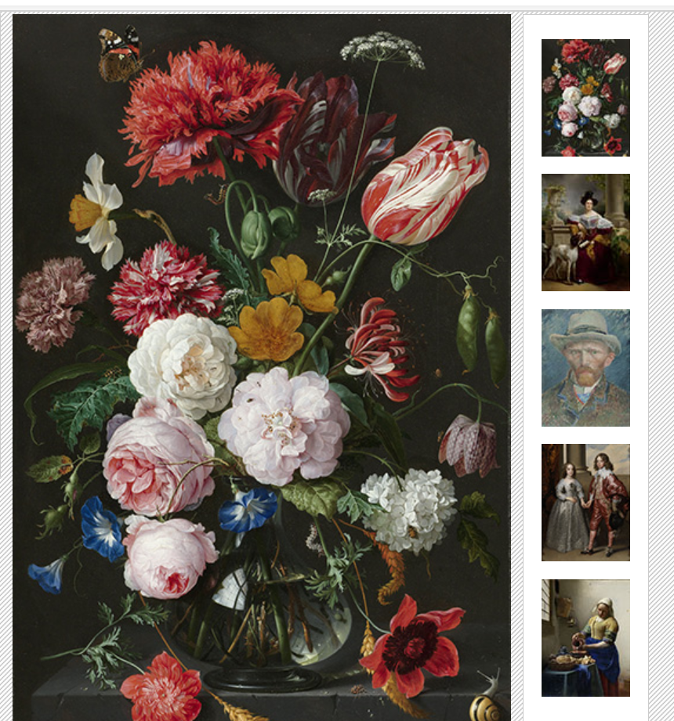
Extra question for you to think: How to use the mouse enter event to select the picture?
When the mouse moves into a thumbnail, show the corresponding big picture
Notes:
$("#thumbBox img").on("mouseenter", function (e) {
var filename = $(e.target).attr("src");
$("#imgManipulated img").attr("src", filename.replace("small","medium"));
var caption = "<em>" + $(e.target).attr("alt") + "</em><br>" + $(e.target).attr("title");
$("#imgManipulated figcaption").html( caption );
});

Slide 15
Final project proposal

Slide 16
Final Project Proposal-due 10/11, 10/13
You can expand your assignment 2 into a project. Or you can start a new project
Think about at least five use cases for your project
For example, for a photo-sharing website,
Signup
Login and logout
Upload photos
Delete photos
Users to add comments to a photo
Save photos to “favorite”

Slide 17
Final Project Proposal-due 10/11, 10/13
Start working on the front-end pages (at least three pages). Feel free to use Bootstrap. We will discuss it in week 8.
Do not worry about the back-end. We will move to the back-end in week 10
Present your front-end pages and your use cases to the class on 10/11 and 10/13. Let me know if you have a preferred date by 10/3
Grading for the final project
Proposal Presentation (5%)
Final project presentation (5%) due week 16
Final project (10%）due final week
Zip your project folder and submit it to Reggienet by 10/13.
Write your user cases in a word document and submit it with the zipped project file.

Slide 18
Before next class
Read w3school tutorials on Bootstrap
https://www.w3schools.com/bootstrap/bootstrap_buttons.asp

